Slide 1
WORKSPOT
Bringing People Together

Slide 2



HalifACT Climate Action Hackathon
Bringing people together

Slide 3
TEAM

Slide 4

Sourav Das

Slide 5

Aoxiang Zhang

Slide 6

Deep Muni

Slide 7

Yijie Wang

Slide 8
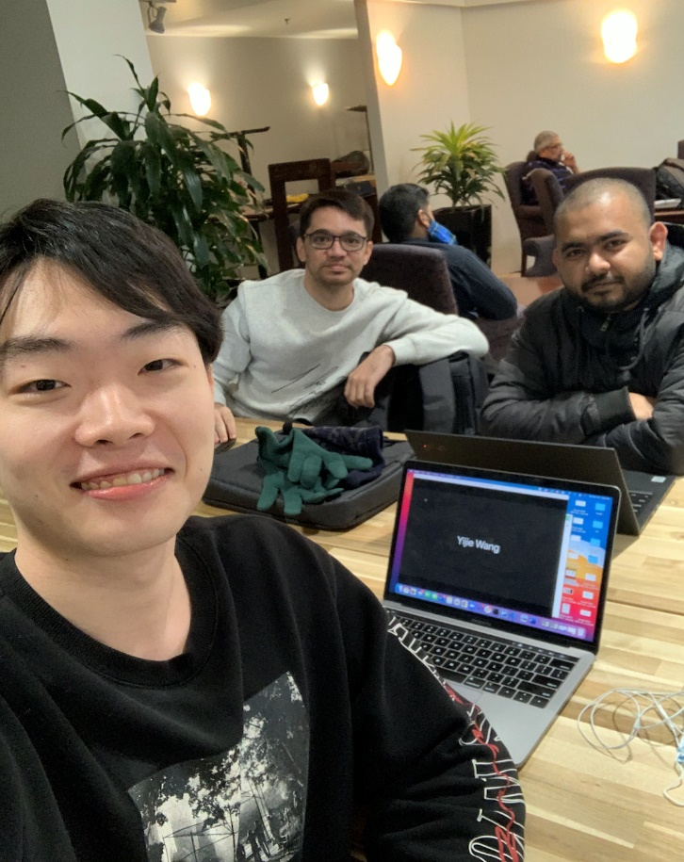
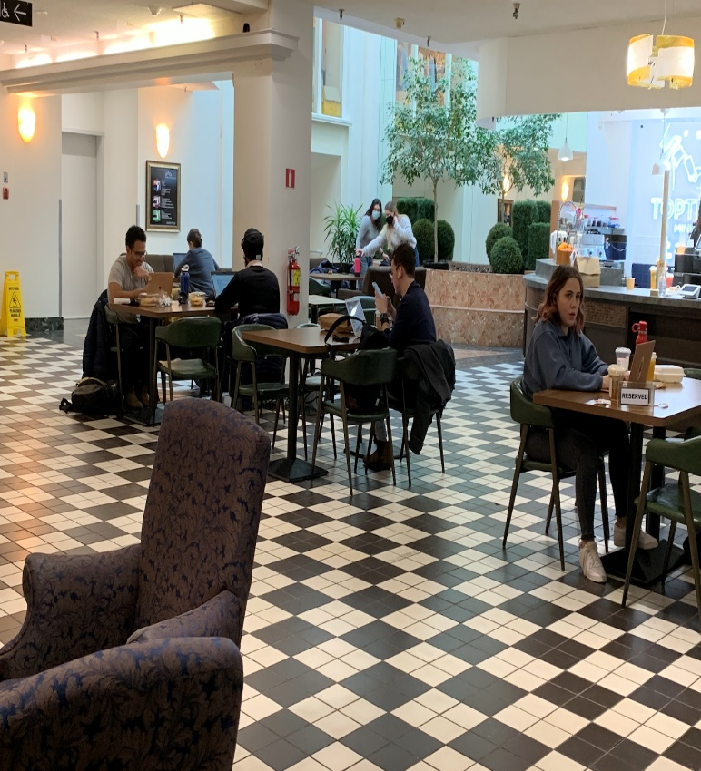
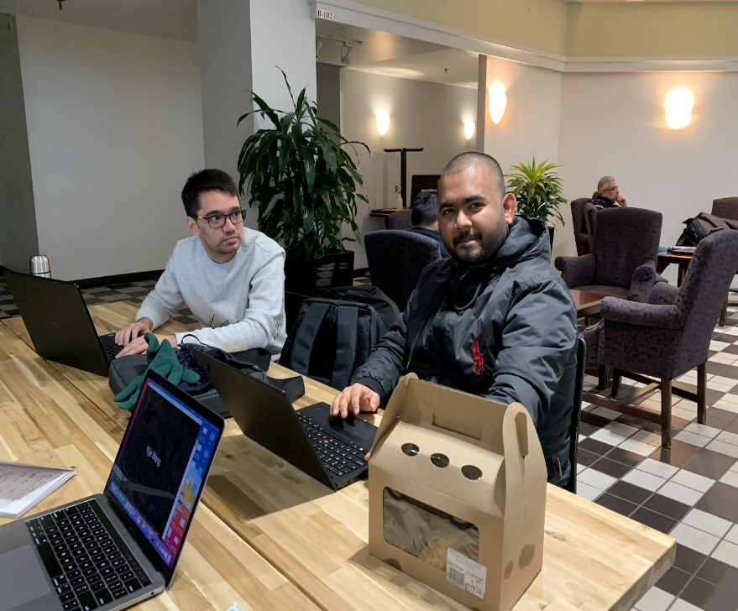
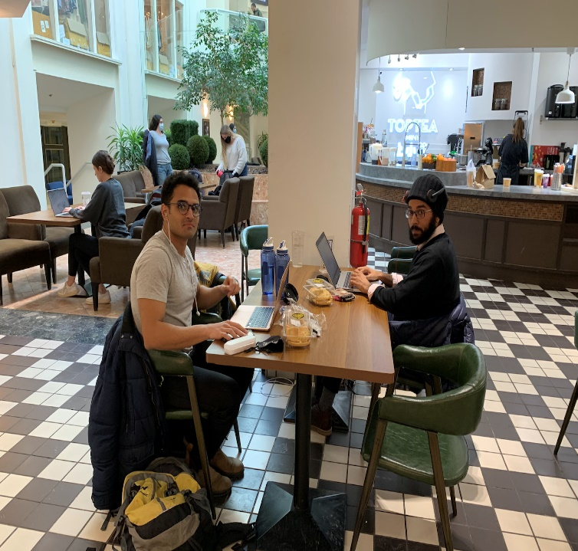
Work time snaps

Slide 9


Slide 10

Challenges
HRM is short of quality and flexible workspaces to work
Homes and coffee shops are not always ideal for working
Individualistic life-style and repetitive consumption of energy
Carbon emission in HRM from commute
Depression and anxiety rate has been rising because of the lack of human connections

Slide 11
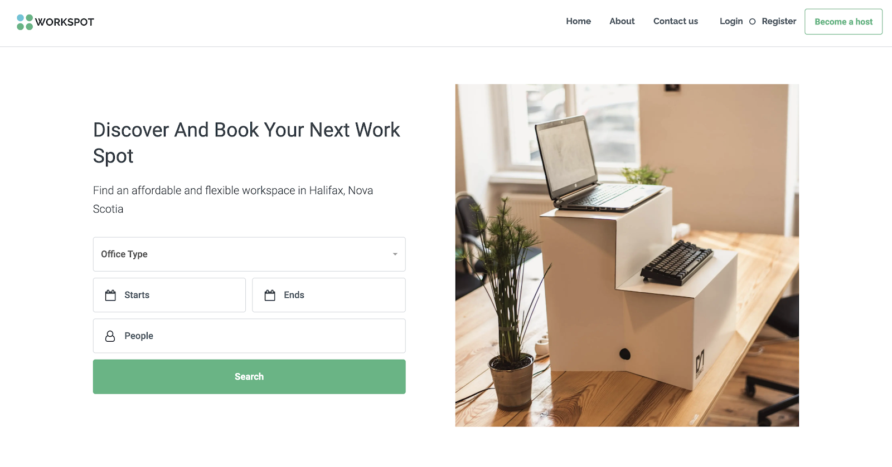
Solution
A peer-to-peer two-sided online marketplace for workspaces. It’s like Airbnb for workspaces!

Slide 12

Problems it solves
Finding ideal workspaces matching exact needs
Finding closest workspaces without excess commute
Isolation, anxiety and depression
Carbon emission from repetitive energy consumption and commute

Slide 13
You can host your apartment or house TODAY by visiting: https://workspot.ca

Slide 14
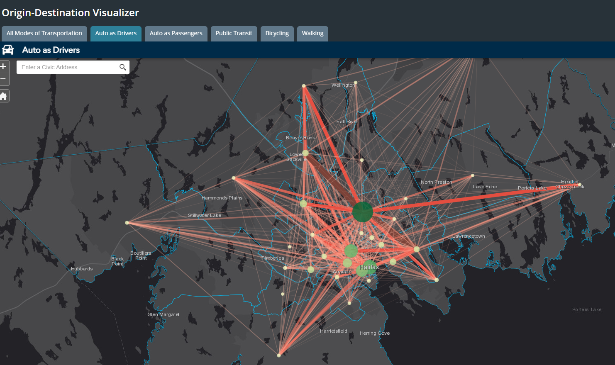
People from all around HRM come to Halifax for work

Slide 15
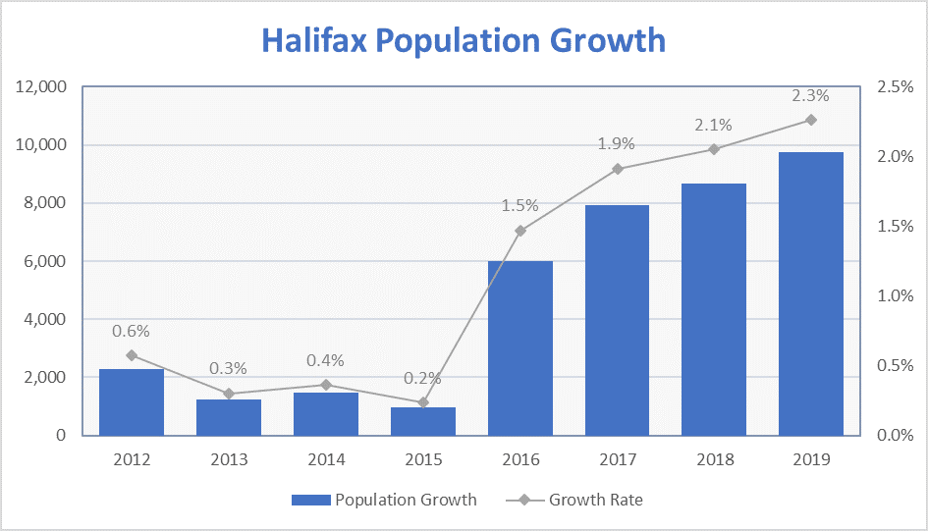
Halifax Population Growth in the recent years

Slide 16
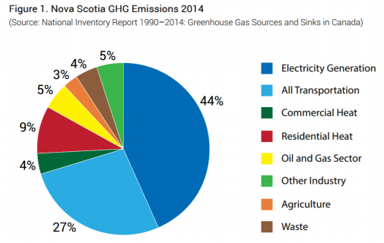
We are working on two biggest sources of emissions: Electricity and Transportation!!

Slide 17
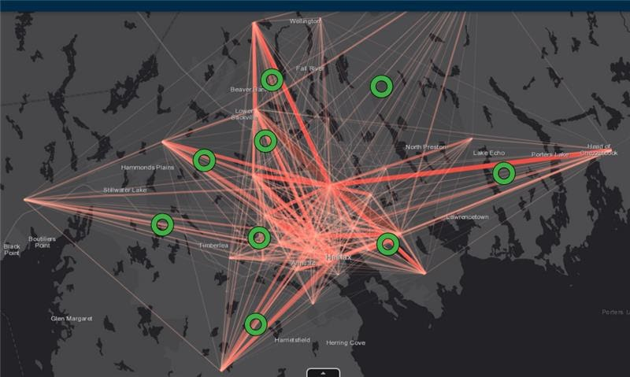
What if we have Workspots on those circled places?

Slide 18

Customer Segment
Young Professionals
Students
Freelancers
Entrepreneurs
Business and working people who travel

Slide 19

Unique value proposition
Networking
Affordable, quiet and comfortable work spaces
Flexible hours & No commitment
Hosts make income off their spare spaces
Insurance, ID verification and review system
Reduce carbon footprint and fight climate change

Slide 20

Unfair advantage
First of its kind in HRM
People are stressed and depressed from the Covid-19 isolation(?)
The founders have big spaces to share
Extended network to test the idea
Friendly and welcoming people of HRM

Slide 21

Channels
Word of mouth
Social media content
Blogs and articles
Influencers
Social media ads
Sponsorships
Customer support

Slide 22
Cost Structure
Activity | Fixed cost $ | Variable cost $
Survey and testing | 2000 | 1000
Development | 10000 | 5000-10000
Application & Database Hosting | 2000 | X
Marketing | 5000 | X
Customer Support | 3000 | 1000
Total | 22000 | 7000-12000
* Costs are estimates based on research. May vary upon situation.

Slide 23
Revenue Streams
Commission
Customer
Loyalty
Subscriptions
Shareable data
Ads
Commission off each transaction
Advertisements
Customer loyalty subscriptions
Shareable Data

Slide 24

Key metrics
Number of accounts created per week
Number of postings per week
Number of bookings per week
Number of ads allowed per week
Number of clicks on the ads per week

Slide 25

Impact
Creating a sense of community
Solving isolation, anxiety and depression issues from the lockdown
Extra income source
Reducing carbon emission from commute & individualistic life-style

Slide 26

Thanks

